Slide 1
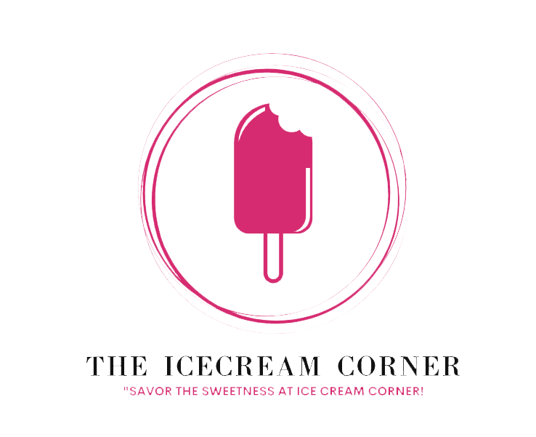
The Icecream Corner
Presentation

Slide 2
Products
Variety of flavors: The Icecream Corner offers a wide variety of classic and unique ice cream flavors, including chocolate, vanilla, strawberry, mint chocolate chip, cookies and cream, and many more.
Custom creations: The Icecream Corner also offers custom ice cream creations, so you can create your own perfect ice cream sundae or milkshake.

Slide 3
Services
Curbside pickup: The Icecream Corner offers curbside pickup for your convenience.
Delivery: The Icecream Corner also offers delivery for orders over $20.
Online ordering: You can order your ice cream online and pick it up in-store or have it delivered.

Slide 4
Testimonials
"The Icecream Corner has the best ice cream in town! I can't get enough of their flavors."
"The quality and taste of their ice cream is unmatched. I highly recommend trying their creations."
"The Icecream Corner is my go-to place for a sweet treat. Their ice cream never disappoints!"

Slide 5
About Us
Introduction: The Icecream Corner is a family-owned and operated business that has been serving traditional and delicious ice cream since 1950.
History: The business was founded by Mr. and Mrs. Smith, who were passionate about creating the perfect ice cream. They used only the finest ingredients and time-honored recipes to create their signature flavors.
Mission: The Icecream Corner is committed to providing its customers with a delicious and memorable ice cream experience.

Slide 6
Contact Information
Address: 123 Main Street, Kyoto, Japan
Phone: +08055760097
Website: www.theicecreamcorner.com

